Slide 1

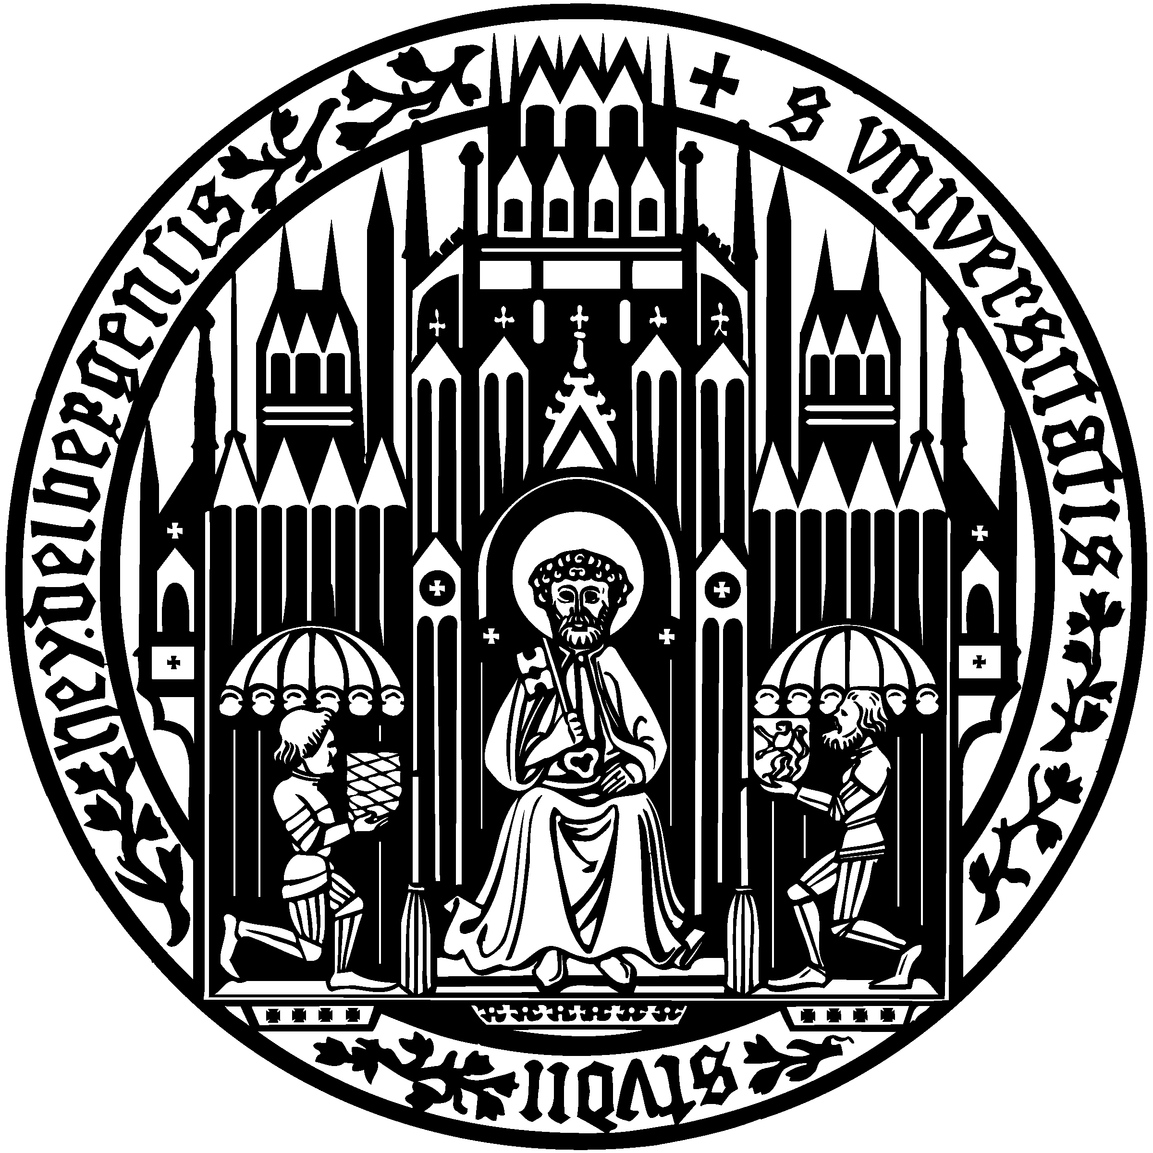
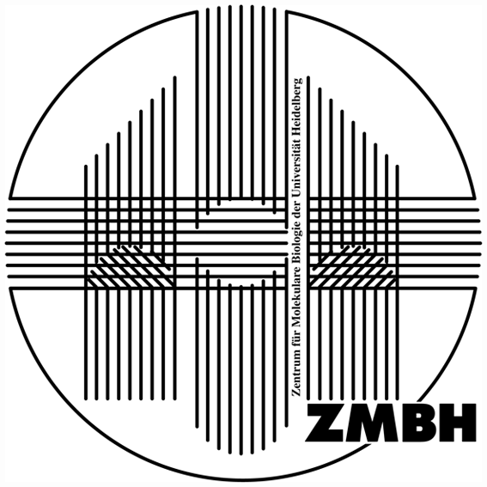
From prokaryotes to eukaryotes: deciphering the “networking code” of
J-proteins
Nadinath Nillegoda
(Bernd Bukau Laboratory)
EPFL, Switzerland 15.11.2016
DEUTSCHES
KREBSFORSCHUNGSZENTRUM
HEIDELBERG, GERMANY
CENTER FOR MOLECULAR BIOLOGY OF THE UNIVERSITY OF HEIDELBERG, GERMANY
Notes:
Working in Bernd‘s lab, City of Heidelberg, study protein quality control in cells, specifically how damaged/ aberrant proteins are rescued in cells.

Slide 2
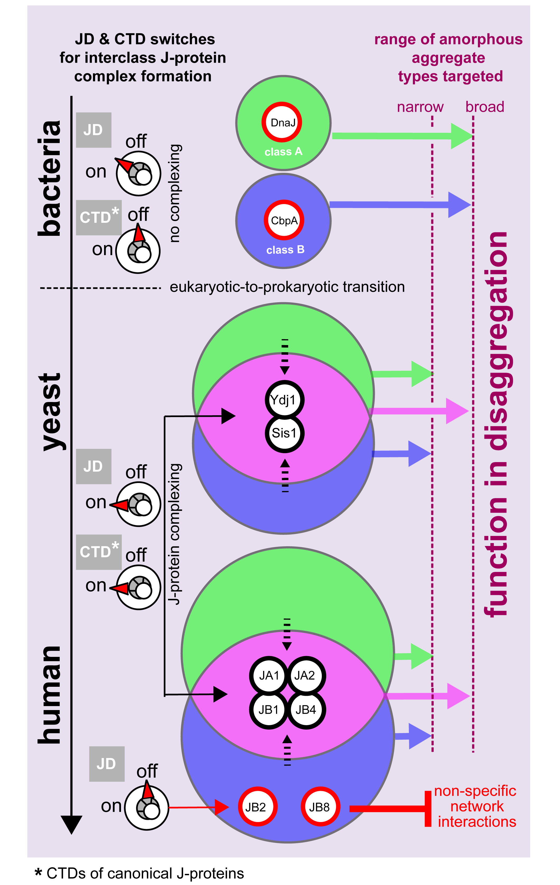
Summary
Mixed class J-protein complex formation key to efficient protein disaggregation in eukaryotes – versatility in function
Origins trace back to prokaryotic-to-eukaryotic split
Networking code for correct J-protein paring embedded in JDs
Expansion of J-protein family with wide range of complexed J-protein combinations provide a gearbox for fine-tuning target selectivity of the Hsp70 machineries

